Slide 1

St. Andrew institute of Technology & Management
A-JIO
Prepared by
Sumit pal
BCA (Section- A)
Roll No- 229089

Slide 2
INDEX
Introduction
Ajio
Navigation Bar
Hobbies
Division
Footer
Bibliography
Thank you

Slide 3
INTRODUCTION
Sumit Pal
From – Auraiya, Uttar Pradesh
BCA 1st year
Roll no- 229089
Academic background
Completed my schooling from J.R.V International School.
10th percentage- 70%
12th percentage- 65%
Graduation- Pursuing (BCA)

Slide 4
A JIO
A Jio is a multicategory online shopping platform.
Download the free A Jio app on your Android phone/tablet and enjoy Free Home Delivery with No Minimum order.
you will get here items related to fashion and Jewellery.

Slide 5
HOBBIES
I Love to play Cricket And Raiding
Watching Movies
I Always try to Learn something new

Slide 6
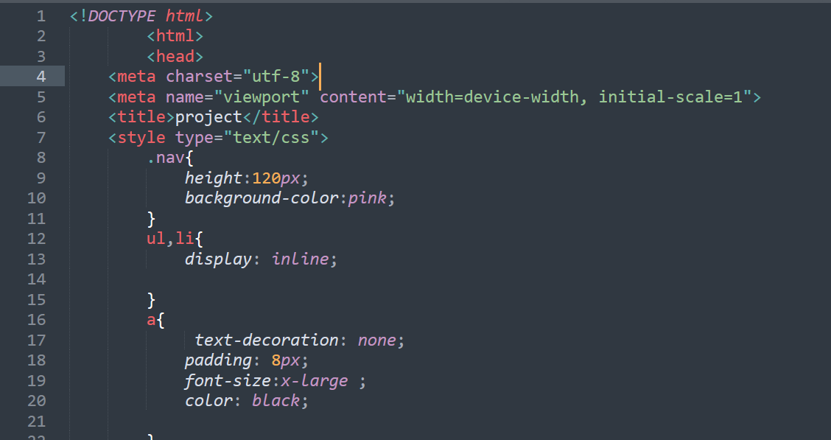
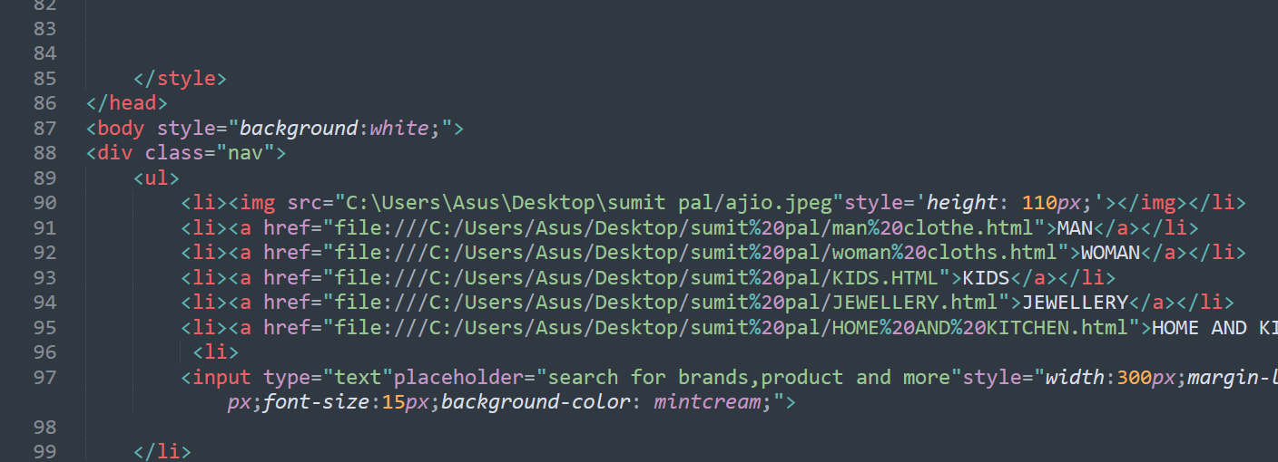
NAVIGATION BAR
SOURCE CODE

Slide 7


CATEGORIES

Slide 8

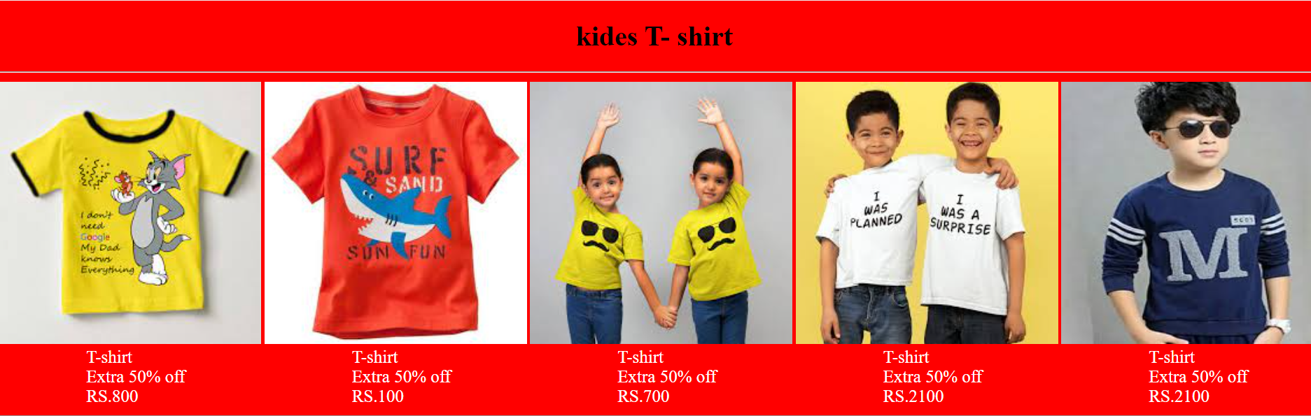

Slide 9

JEWELLERY

Slide 10
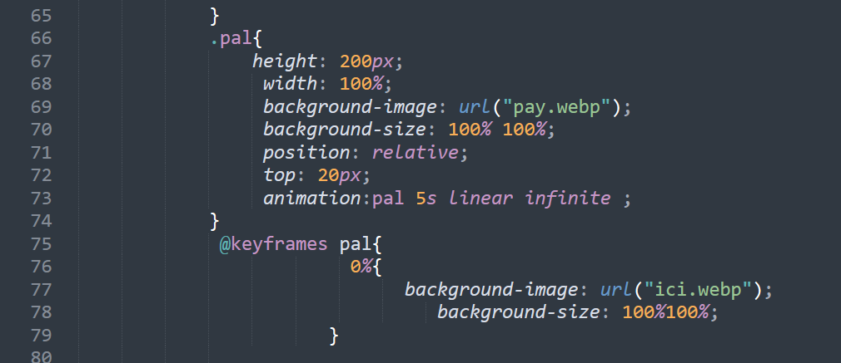
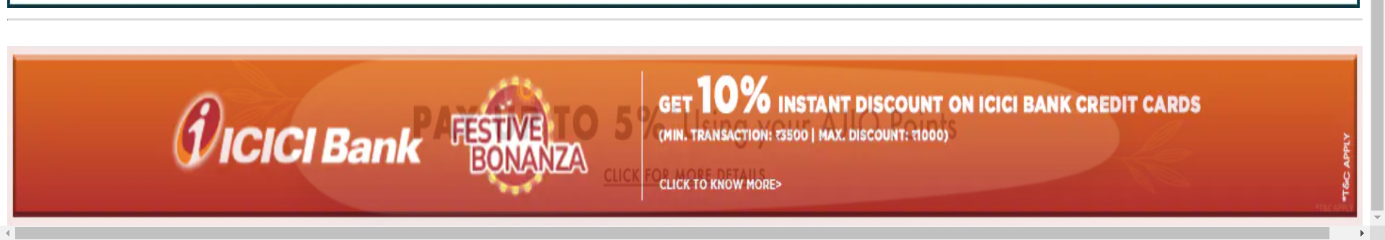
DIVISION
SOURCE CODE
OUTPUT

Slide 11
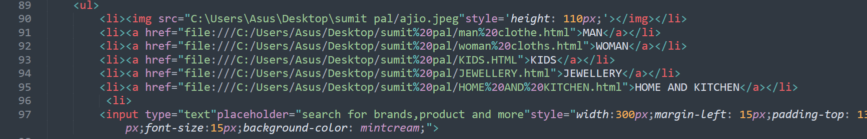
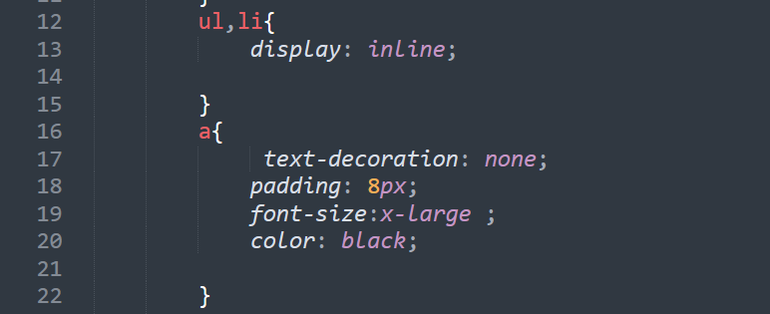

FOOTER
SOURCE CODE
OUTPUT

Slide 12

Thank you

